Slide 1
DB List control

Slide 2
DB Controls
Three useful controls for working with databases are:
DBList control (dbl)
DBCombo control (dbc)
DBGrid control (dgd)
You will need to add them to the toolbox by using the Project|Components menu option

Slide 3
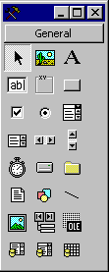
Data
DBList
DBGrid
DBCombo

Slide 4
The DBList and DBCombo Controls
The DBList and DBCombo controls are useful for displaying just one column of the database table for all or selected rows.
They are read-only controls in that you cannot edit the database through them

Slide 5
Properties and Methods:
Both controls support same methods and properties
RowSource contains the name of the recordset that will be visible
ListField specifies the field in the RowSource
BoundColumn identifies second field in the ADO data control indicated by RowSource
When an item in the list is selected, BoundText becomes updated to the value in BoundColumn
DataSource contains the name of the recordset to be updated
DataField specifies a field in the DataSource

Slide 6
Recordset - a record(s) selected from a table(s) in a database
Table recordsets - limited to a single table, and can modify records
Dynaset recordsets - can be used for multiple tables, and can modify records
Snapshot recordsets - can be used for multiple tables, but cannot modify records

Slide 7
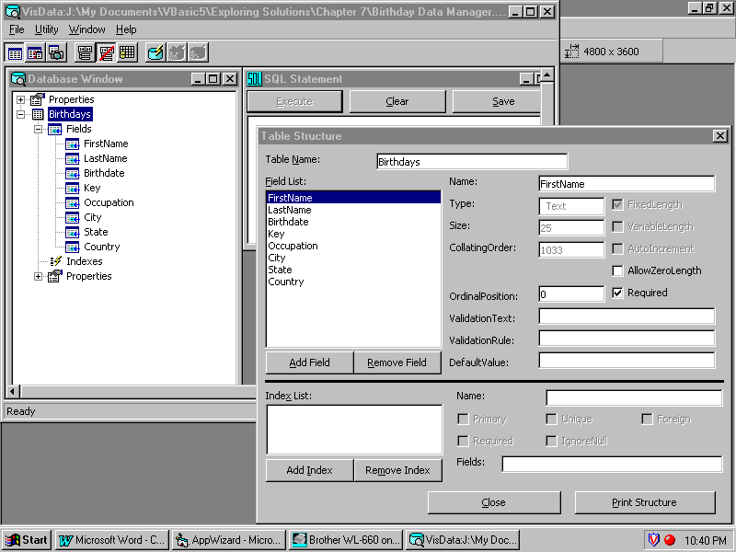
Visual Data Manager
Add a Field
Remove a Field

Slide 8
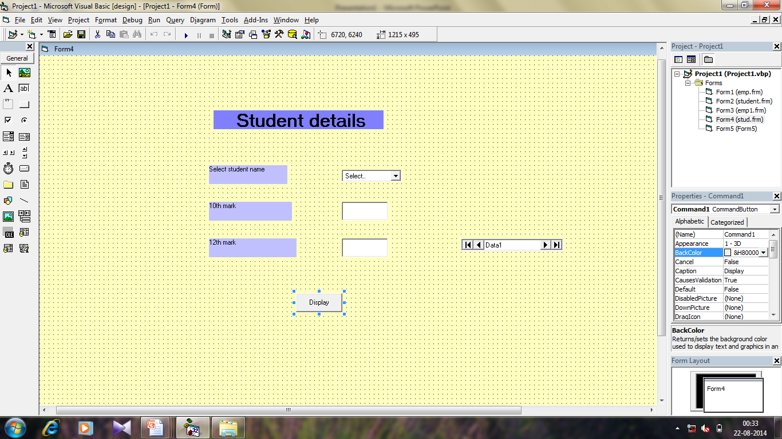

Slide 9
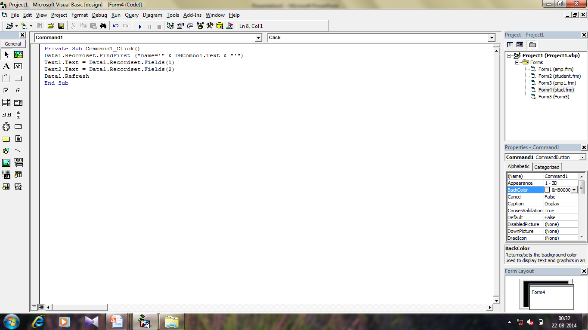

Slide 10
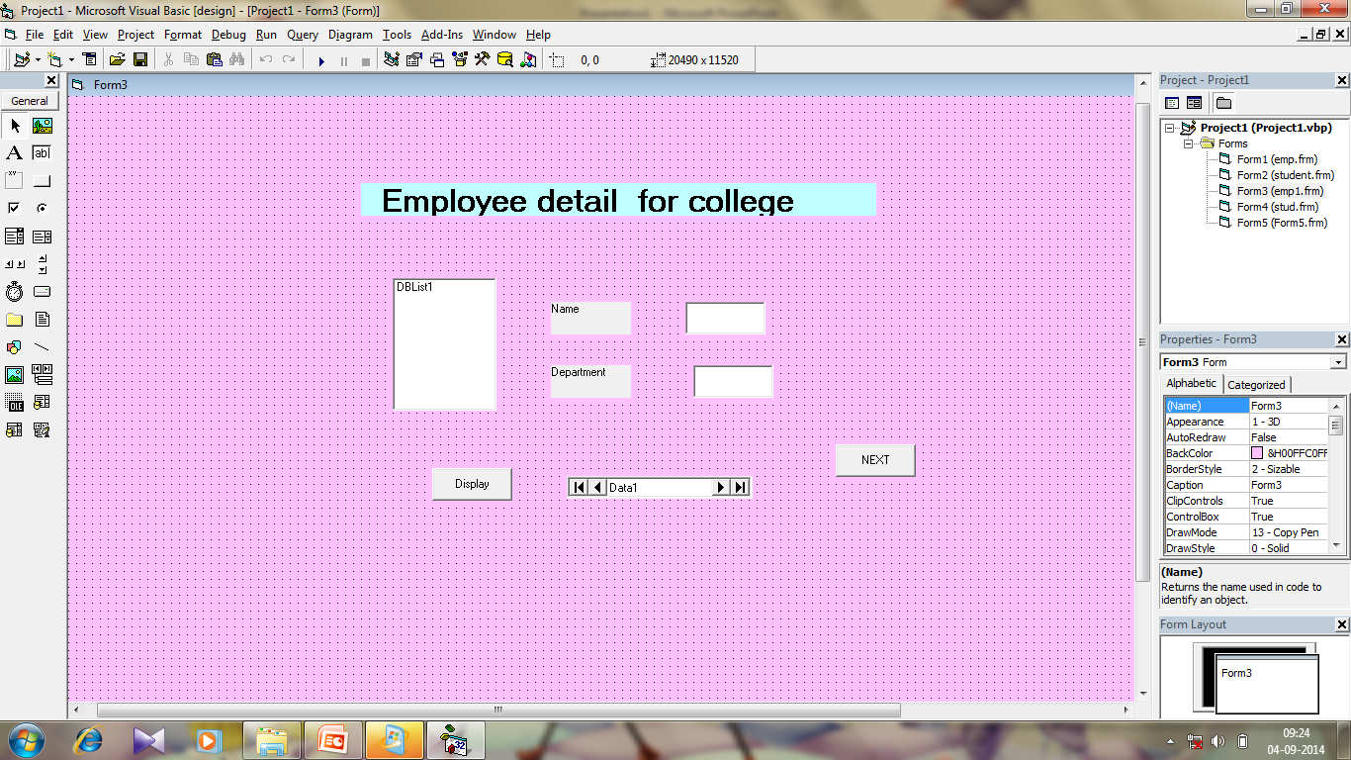

Slide 11
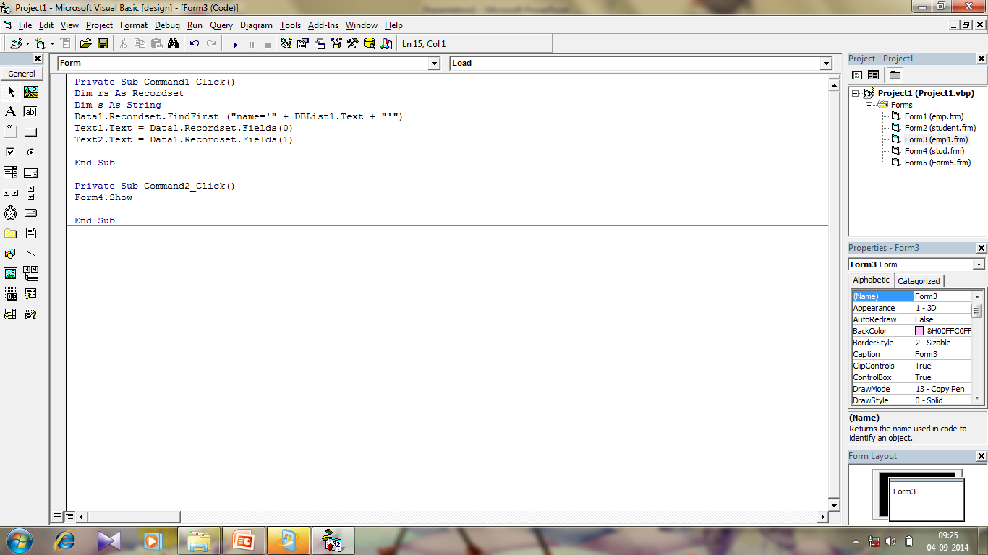

Slide 12
Microsoft Data List Control

Slide 13
Outline:
Definition.
Two Bound Data Custom Tool.
DataList
DataCombo

Slide 14
Definition of DataList Box:
In the dataList, here are two custom data aware tools, in addition to the standard Visual Basic tools:
DataList
DataCombo ADO tools
It has some properties and some events.
If the icons for these tools are not in the toolbox
select Project from the main menu, then click Components.
Select Microsoft DataList Controls 6.0 (OLEDB) in the Components window.
Click OK - the controls will appear.

Slide 15
DataList Box:
The first bound data custom tool is the DataList Box. The list box is automatically filled with a field from a specified data control
Some properties of the DataList box are:
DataSource - Name of data control that is updated by the selection.
DataField - Name of field updated in Recordset specified by DataSource.
RowSource - Name of data control used as source of items in list box.
ListField - Name of field in Recordset specified by RowSource used to fill list box.

Slide 16
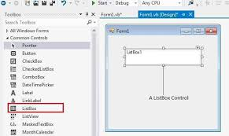

Slide 17
Properties of DataList:
BoundColumn - Name of field in Recordset specified by RowSource to be passed to DataField, once selection is made. This is usually the same as ListField.
BoundText - Text value of BoundColumn field. This is the value passed to DataField property.
Text - Text value of selected item in list. Usually the same as BoundText.

Slide 18
DataCombo Box:
The DataCombo Box is nearly identical to the DataList box, hence we won’t look at a separate set of properties.
The only differences between the two tools is that, with the DataCombo box, the list portion appears as a drop-down box and the user is given the opportunity to change the contents of the returned Text property.

Slide 19
